Slide 1
Database connectivity :
Using Sqlite, mysqldb
Download :https://www.sqlite.org/download.html :https://visualstudio.microsoft.com/visual-cpp-build-tools/
Create database.
Get connection : Sqlite3.conn()

Slide 2
NumPy, SciPy, Pandas, SciKit-learn :
Install using pip.main() command.
NumPy – To do numerical computations. Contains mathematical functions. -- Internally, it uses arrays of fixed size.Array size could be in millions.
-- Single memory block. Fast performance.
SciPy -- For scientific calculations
Pandas - To analyse data of millions of records, clean data - Datatypes : Series, DataFrame, Panel - Series is basics/fundamental for dataframe. - Dataframe is for 2 dimensional array. Mostly used data type. - Panel is for 3 dimensional array.
SciKit-learn – For machine learning.

Slide 3
NumPy
In year 2005. (Numeric + NumArray) = NumPy, was developed by Travis Olipant
wide range of mathematical functions for basic arithmetic, linear algebra, Fourier analysis, etc.,
numerical operations on large datasets efficiently.
supports multi-dimensional arrays, allowing for the representation of complex data structures such as images, sound waves, and tensors in machine learning models.
Widely used in AI, Machine learning, Finance , Economic, Image processing.
Online : https://www.tutorialspoint.com/execute_numpy_online.php

Slide 4
NumPy :
Syntax : numpy.array(object, dtype = None, copy = True, order = None, subok = False, ndmin = 0) Data types : bool , int8 ,int16 , int32, int64 , uint8 ,uint16 , uint32,
uint64 , float16, float32, float64 , complex64, complex128
Data type object - Construction : numpy.dtype(object, align, copy) import numpy as np
dt = np.dtype(np.int32)
print dt
# first create structured data type import numpy as np dt = np.dtype([('age',np.int8)]) print dt

Slide 5
NumPy :
//One dimensional array
import numpy as np
age = np.array([21,32,23])
print age # more than one dimensions
empIDAge = np.array([[21, 42], [23, 4]])
print empIDAge
Range : numpy.arange(start, stop, step, dtype)

Slide 6
NumPy :
import numpy as np
a = np.array([0,30,45,60,90])
print 'Sine of different angles:’ # Convert to radians by multiplying with pi/180
print np.sin(a*np.pi/180)
print 'Cosine values for angles in array:’ print np.cos(a*np.pi/180)

Slide 7
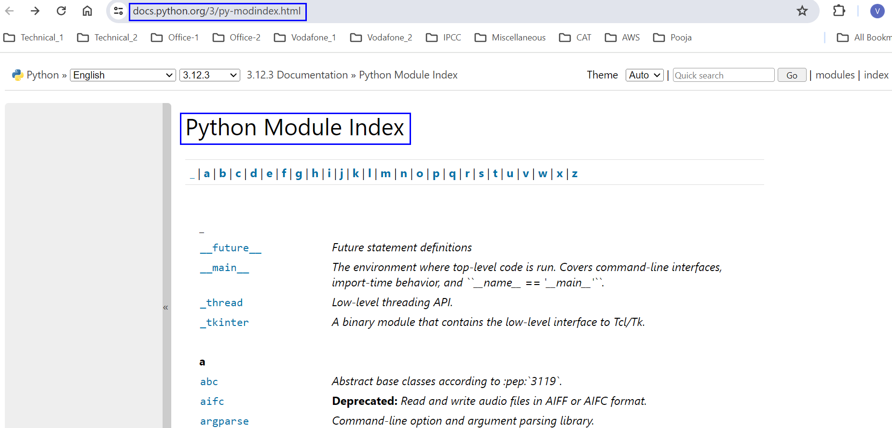
Built-in modues:
-- Using help(‘modules’)
From Python website :

Slide 8
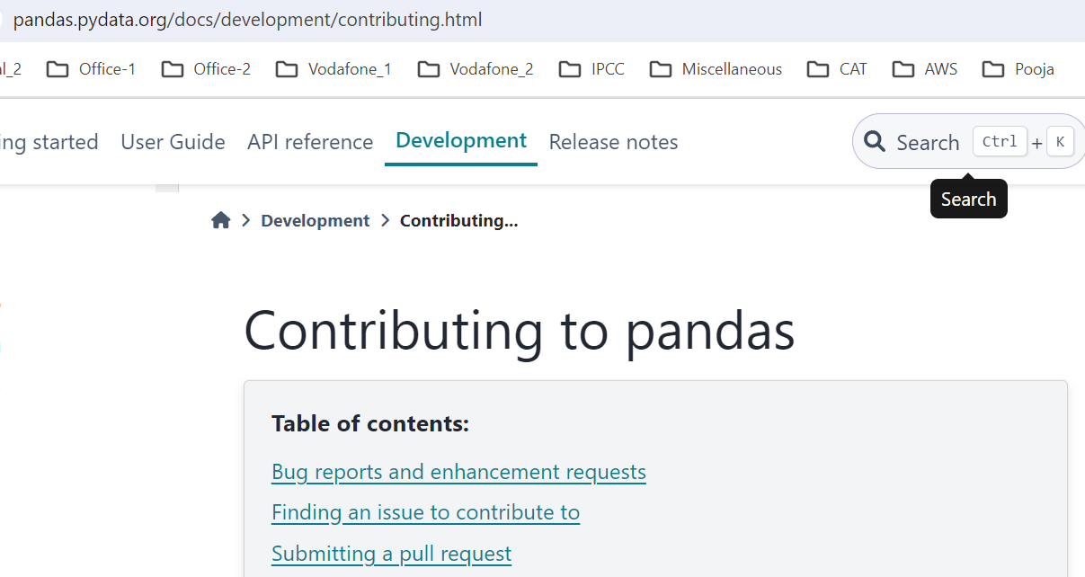
Pandas -1 :
Abbreviation to words ‘Panel Data’ & ‘Python data analysis’.
Objective of Pandas : To identify relationship of a parameter, with other parameter
Developed by Wes McKinney , in year 2008.
Open source library. Source code is available in following Url : https://github.com/pandas-dev/pandas/tree/main/pandas/core
Any developers can contribute to Pandas library.

Slide 9
Pandas - 2 :
In Pandas – 3 data types exists – Series, DataFrame, Panel
To handle data set, which is in rows & columns
DataFrame is a dictionary with values in List data type. -- Column names of the data set is a key . -- Values in rows are items in List data type. Example : {‘EmpName’:[‘Ramesh’, ‘Williams’,’Narendran’],
‘Emp Id’ : [10020,23100,11232],
‘Salary’ : [10000,12300,9500] }

Slide 10
Example :
import pandas as pd exercise = { "calories": [420, 380, 390], "duration": [30, 40, 45] } #load data into a DataFrame object: df = pd.DataFrame(exercise) print(df)

Slide 11
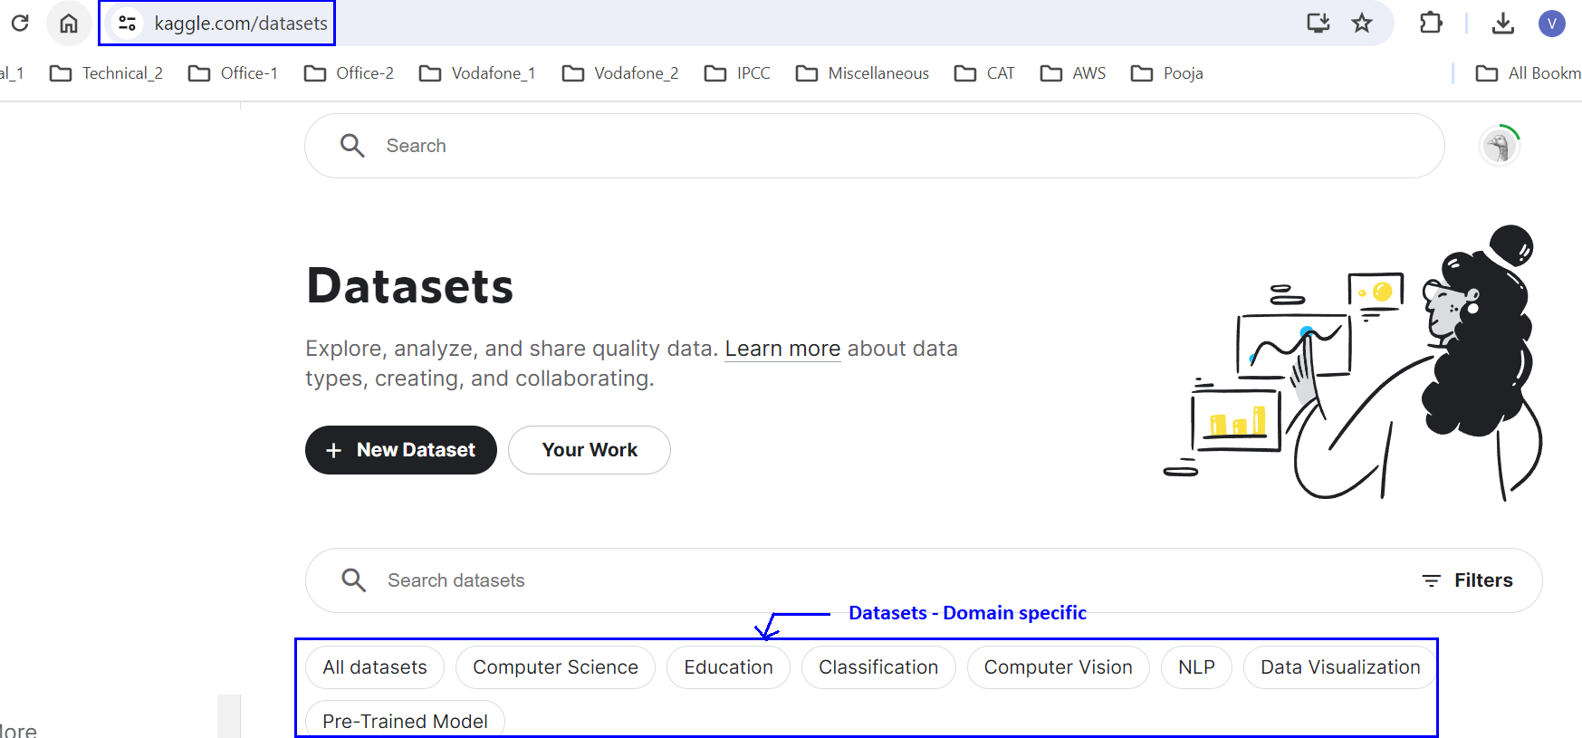
Dataset – To do practice

